Slide 1
Critical Thinking & IT Concepts
Week 4 – The Internet and 3-tier Model

Slide 2
Brief history of Internet
What is Internet and how was it started?
https://www.youtube.com/watch?v=Dxcc6ycZ73M&list=PLzdnOPI1iJNfMRZm5DDxco3UdsFegvuB7
IP Address and DNS
https://www.youtube.com/watch?v=5o8CwafCxnU&t=12s

Slide 3
IP address and Packet Switching
The Internet: Packets, Routing and reliability
https://www.youtube.com/watch?v=AYdF7b3nMto&index=4&list=PLzdnOPI1iJNfMRZm5DDxco3UdsFegvuB7

Slide 4
Brief history of Internet
1969: ARPAnet – 4 computers
Used Transmissions Control Protocol/Internet Protocol (TCP/IP)
1991: Tim Berners-Lee invents links (“hypertext”)
Created the code for the World Wide Web using Hypertext Transfer Protocol (HTTP)
Documents could be formatted using Hypertext Markup Language (HTML) in order to be read properly
1993: Mosaic is the first “graphics-based” web browser

Slide 5
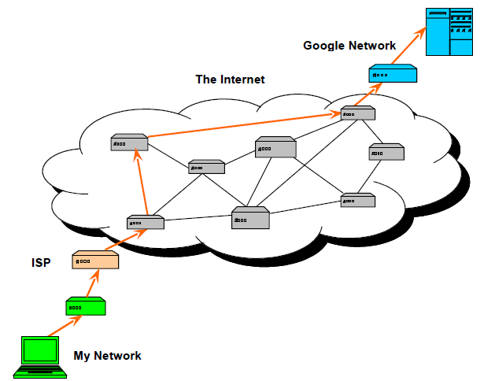
Internet

Slide 6
Internet
Internet allows computer in one network to talk to computers in other networks
Orange line in the previous diagram shows what happens when you submit search to Google. It is sent from your network to the Internet which further sends it to Google’s network
The Internet is shown as cloud in diagram. Cloud refers to remote storage

Slide 7
Internet
When you use cloud services like Dropbox, your computer connects to the server that provides a lot of disk storage to backup
The boxes inside cloud are called routers. Router routes data received from one device on the network to the destination

Slide 8
The Internet
Within each network, there is at least one host computer that connects to the internet with a unique Internet Address.
Each host computer that connects to the internet uses the TCP/IP protocol for assigning addresses and packet switching for forwarding information.

Slide 9
Packet Switching
With the TCP/IP Internet protocol, the network connection layer conducts a series of operations:
Convert the address of the server at the destination from the text form (ymail.com) to an IP address
The network connection divides the message into packets, each of which contains a specific number of bytes. Each packet receives a sequence number and a destination address
1100110101011100110011
11001101010
198.137.240.92
11100110011
198.137.240.92

Slide 10
IP Addresses and the DNS
Every computer connected to the Internet
has an IP address (e.g. 74.125.95.104)
The Domain Name System (DNS)
associates IP addresses with domain
names (e.g. google.com)
TCP/IP works with the DNS to send
information to the correct computer by
translating a URL (http://www.google.com)
into its associated IP address
(74.125.95.104)

Slide 11
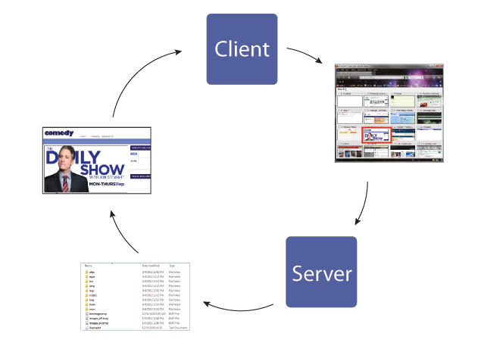
The Client/Server Model

Slide 12
The Client/Server Model
Your Computer
Use web browser to go to http:://funsite.ca

Slide 13
The Client/Server Model
Request travels to the server (another
computer) where the funsite website is
stored

Slide 14
The Client/Server Model
The requested/associated information is retrieved from the server’s file system

Slide 15
The Client/Server Model
The information is sent
back to your computer

Slide 16
The Client/Server Model
Your web browser
interprets the
information and displays
the web page

Slide 17
The Client/Server Model
Some code is processed on the server
before being sent to the client (server-
side code).
Other code, such as JavaScript, is
processed on the client’s computer, in the
web browser (client-side code).

Slide 18
Internet Protocols
The exchange of information between
client and server is accomplished via
protocols
A protocol is an accepted data format for
communication between computers.
Data is sent in “packets” over the internet
Larger data must be split into multiple packets
Each packet must have IP information at the beginning to conform to the Internet protocol

Slide 19
Internet Protocols
HTTP: Hypertext Transfer Protocol
Used to transfer text and multimedia on the web
Browser <----> Server
FTP: File Transfer Protocol
Used to transfer files from one computer to another
Developers can use FTP to transfer files to their “live” site
Often upload/download is accomplished through FTP
TCP/IP: Transmission Control
Protocol/Internet Protocol
TCP breaks files into packets of information
IP controls how the packets get sent from one computer to another

Slide 20
Internet Protocols
SMTP/IMAP/POP: Email protocols
Used to transfer emails between the outgoing and incoming mail servers
SMTP stands for Simple Mail Transfer Protocol
IMAP stands for Internet Message Access Protocol
POP stands for Post Office Protocol

Slide 21
How the internet works? - Summary
Router reads the destination address in the IP header of packet
It determines the destination network from that address and forwards the packet to the next router according to fastest and shortest path
This process goes on until packet reaches at destination network
Packet is then delivered to the destination machine by routers on local network

Slide 22
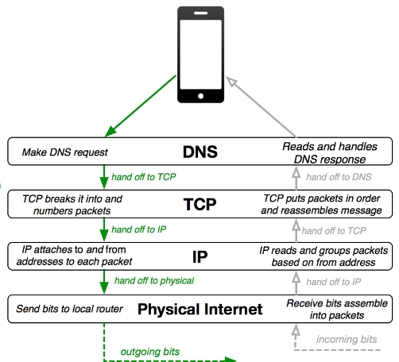
Internet Protocols
The Internet Protocol Stack

Slide 23
How does Internet work?
Watch the following video for quick review of ‘how does internet works’?
https://www.youtube.com/watch?v=i5oe63pOhLI

Slide 24
3-Tier Architecture
Client GUI Interface Browser
(I/O Processing)
Application Server Business rules Web Server
Database Server Data storage DBMS
Thin Client
PC just for user interface and a little application processing. Limited or no data storage.

Slide 25
3-Tier Architecture
Web based Client Server System follow three tier architecture.
An application is divided into three parts.
Client side code runs on Web Browser
Server side code runs on Web Server and
Database is stored and maintained in a database server.
Server is a software used to provide services to other software and applications.

Slide 26
3-Tier Architecture
Web Server is a special type of Server used to post the web pages requested by the Web Browser.
It also compiles and executes the Server side code if it is embedded in the requested web page.
Server side code contains logical decisions, evaluations, performs calculations, accesses database and manipulate data.

Slide 27
3-Tier Architecture
Web Browser is the client software or application used to request the web pages.
It interprets the HTML and displays the webpage and its contents.
The communication protocol at application layer between Web Browser and Web Server is HTTP protocol.
A database server is dedicated to providing database services.

Slide 28
How does it work?
Web Browser requests a web page .
The Web Server processes the request and responds by sending the requested web page.
The Web Browser interpreters the web page and displays it.
After getting the page, the user enters some inputs and clicks the submit button (for example).
But before submitting the web page, Web Browser interprets the client side code; if some requirements are not fulfilled by the user; asks the user to complete those requirements.

Slide 29
How does it work?
If all validations are complete, then resends the webpage to Web Server.
The Server processes the Server side code embedded in the webpage and processes all the instructions and sends the web page to the Web Browser again.
The Web Browser again interprets the web page and displays it.

Slide 30
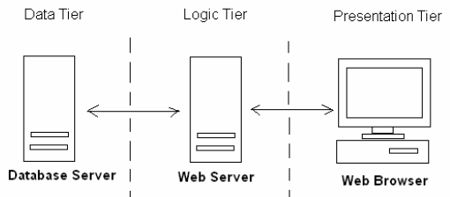
How does it work?
The Web Pages embedded with client side code executed on Web Browser are known as Presentation Tier which includes simple controls and user input validation. This application is also known as a thin client.

Slide 31
How does it work?
Server side code executed on Web Server is known as the Logic Tier which makes logical decisions, evaluations, perform calculations and access data.

Slide 32
How does it work?
Third tier is Data Tier. The database resides on the Database server is known as Data Tier.

Slide 33
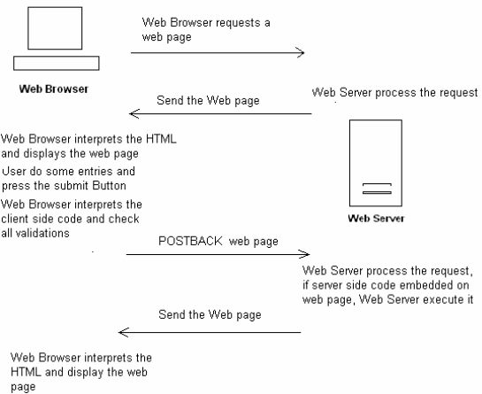
Communication steps between Web Server and Web Browser

Slide 34
Why it is used?
Benefits are:
It is easier to modify or replace any tier without affecting the other tiers.
Separating the application and database functionality means better load balancing.
Adequate security policies can be enforced in each tier.

Slide 35
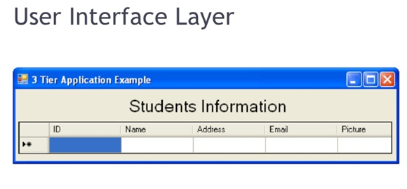
3-Tier Application Example
Presentation Layer

Slide 36
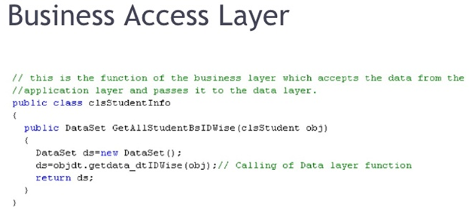
3-Tier Application Example

Slide 37
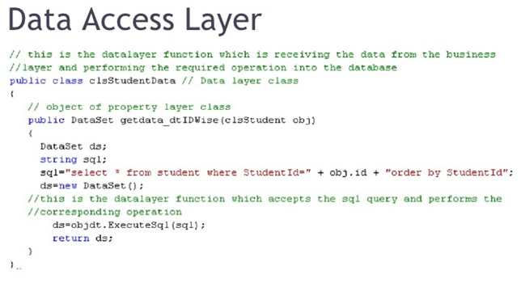
3-Tier Application Example

